Slide 1
Insurance profiling
Valknut solutions

Slide 2
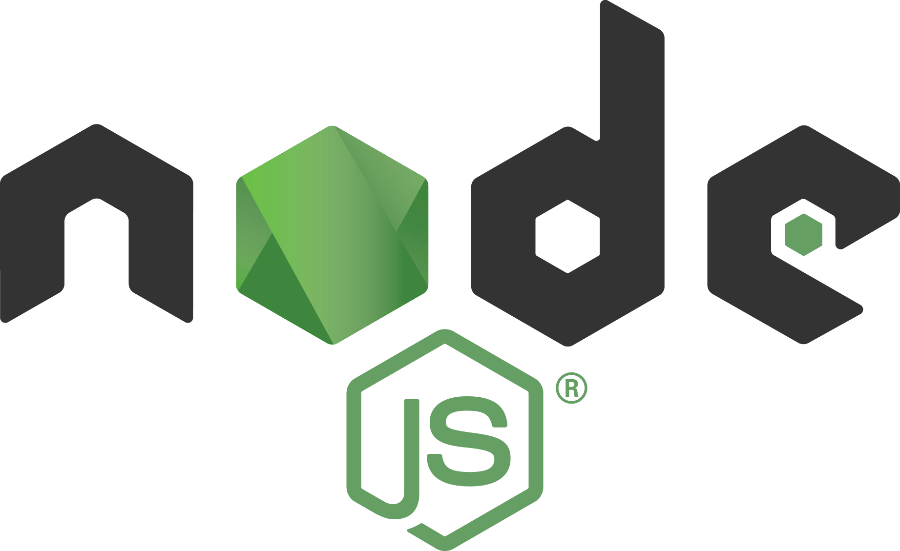

Backend:
OR

Slide 3







Development Flow:
Notification
Notify
Deploy if pass
Notify
Deploy from master
Notification
Test
Notify
Agile
push

Slide 4
vs
Pros
Uses C# as backend language
Runs primarily on Microsoft Windows
Object orientated
Good for CPU intense workloads
Rapid Application Development – Drag an drop options, generate HTML
Visual studio is a powerful IDE
Open source
Cross platform support
Uses Javascript which is also platform independent
Npm (Node package manager) is easy to use
Asynchronous event driven IO helps concurrent request handling.
Dependency installation is quick and easy
Heroku integration is a breeze
Lightweight in terms of resource use

Slide 5
vs
Cons
Limited control over generated HTML
Limited cross platform support – not intended to be used outside of MS environment
Does not integrate well with Heroku PaaS hosting
Visual studio = expensive upkeep and resource intensive
Not object-orientated
Not intended for CPU- intensive code, focuses on event driven IO
External libraries are needed for common features such ORM
Does not support pure multithreading but rather event driven IO by means of callbacks

